Slide 1

Day 2 Git and Github Tutorial
By
Jitin Singh
Notes:
hey everyone this is Rachel from eddy Eureka and today's tutorial we're going
0:05
to learn about git and github now if you're someone who's new to coding and
0:10
you might be hearing your fellow developers talking about git and github but you don't know what they actually
0:16
are and you have never used it then this tutorial my friend is just for you and
0:21
even if you are one of those people who have been using git and github for a while but you're a little doubtful that
0:28
there might be some kind of get features that you have left unexplored then I'll just tell you just hang in there till
0:34
the end of this tutorial and please let me know if you have learned something new so I would like to welcome and thank
0:41
all the attendees for joining today's session but before I begin am i audible to everyone so john says yes so without
0:51
any further ado let us begin this tutorial by looking at the topics that we'll be learning today said first we'll
0:59
see what is version control and why do we actually need version control after
1:05
that we'll take a look at the different version control tools and then we'll see all about github and git will also take
1:13
an account a case study of the dominant enterprises about how they're using github after that we'll take a look at
1:20
the features of git and finally we're going to use all the git commands to perform all the git operations so this
1:27
is exactly what we'll be learning today so is the agenda clear to everyone so

Slide 2
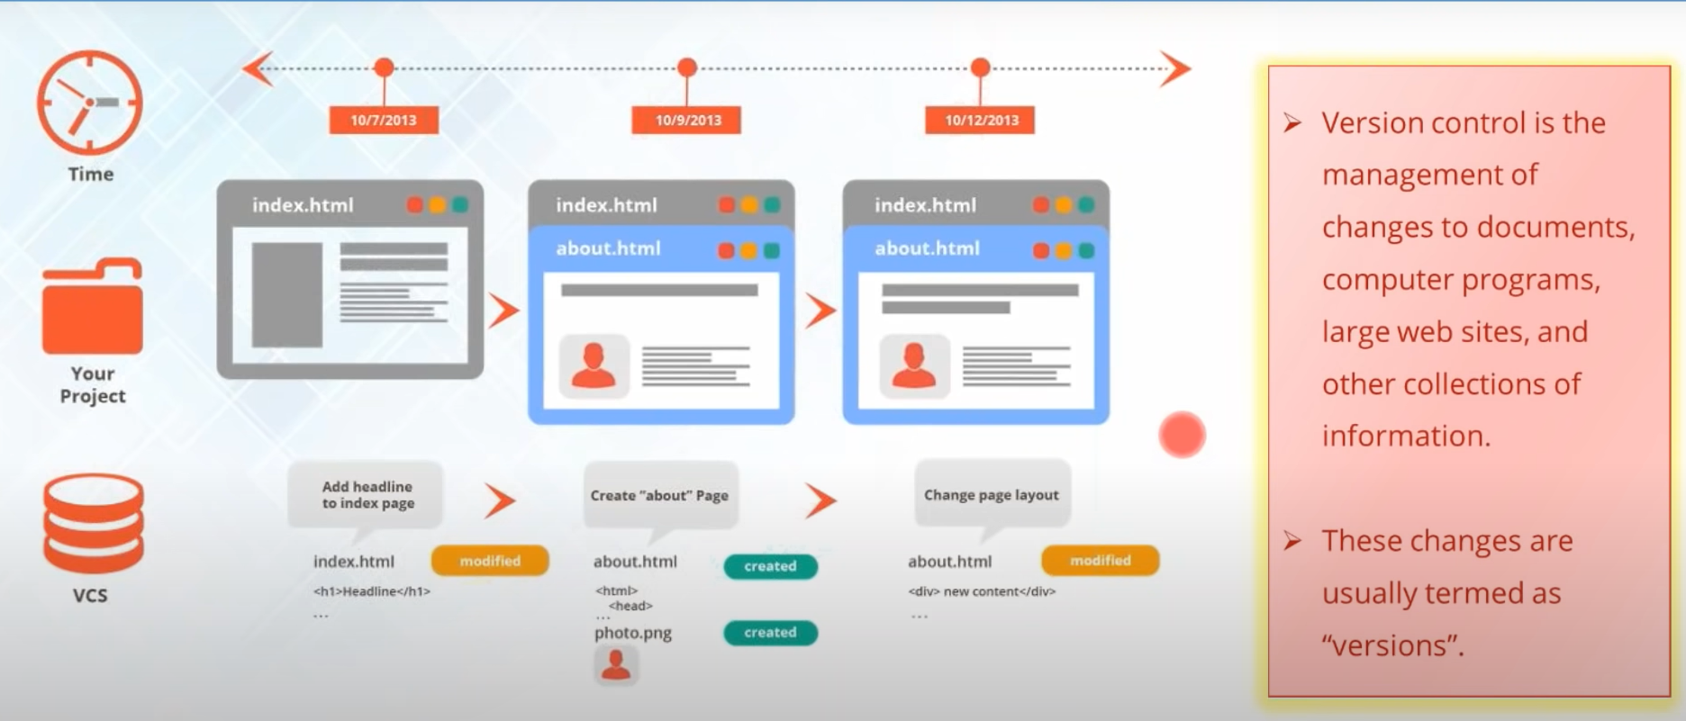
Why version Control
Notes:
John says yes Tyler says yes so we're good to go let us begin with the first
1:38
topic what is version control well you can think of a version control as the
1:45
management system that manages the changes that you make in your project till the end the changes that you make
1:52
might be some kind of adding some new files or you're modifying the older files by changing the source code or
1:59
something so what the version control system does is that every time you make a change in your project it creates a
2:06
snapshot of your entire project and save it and these snapshots are actually
2:11
known as different versions now for having trouble with the word snapshot just consider that
2:17
snapshot is actually the entire state of your project at a particular time it
2:22
means that will contain what kind of files your project is storing at that time and what kind of changes you have
2:29
made so this is what a particular version contains now if you see the example here let's say that I have been
2:35
developing my own website so let's say that in the beginning I just had only
2:41
one webpage which is called the index dot HTML and after a few days I have
2:47
added another web page to it which is called about dot HTML and I have made some modifications in the about dot HTML
2:54
by adding some kind of pictures and some kind of text so let's see what actually the version control system stores to see
3:02
that it has detected that something has been modified and something has been created for example it is storing that
3:08
about dot HTML is created and some kind of photo is created or added into it and
3:14
let's say that after a few days I have changed the entire page layout of the
3:19
about dot HTML page so again with version control system will detect some kind of change and will say that some
3:27
about dot HTML has been modified and you can consider all of this three snapshots as different versions so when I only
3:34
have my index or HTML web page and I do not have anything else this is my version 1 and after that when I added
3:41
another web page this is going to be a version 2 and after have changed the page layout of my web page this is my
3:49
version 3 so this is how a version control system stores different versions so I hope that you've all understood
3:55
what is a version control system and what are versions so if you have any kind of doubts you might ask me and if
4:02
not give me quick confirmation on the chat window so that I can move on to the next topic ok so John has a question he asks that
4:10
can we go back to a previous version if you make a mistake yes of course that is the whole purpose of a version control
4:17
system because sometimes you make changes and you don't want them so a version control system always keeps your
4:24
older versions neat packed inside it only because if at anytime sometimes you want to roll back
4:31
to the previous version you can do that that is the whole purpose of maintaining your version virtual system
4:36
I hope John you have got your answer okay Seth yes thank you so much so let
4:42
us move on to the next topic and now we'll see why do we actually need
4:48
version control because you might be thinking that why should I need a version control I know what the changes

Slide 3
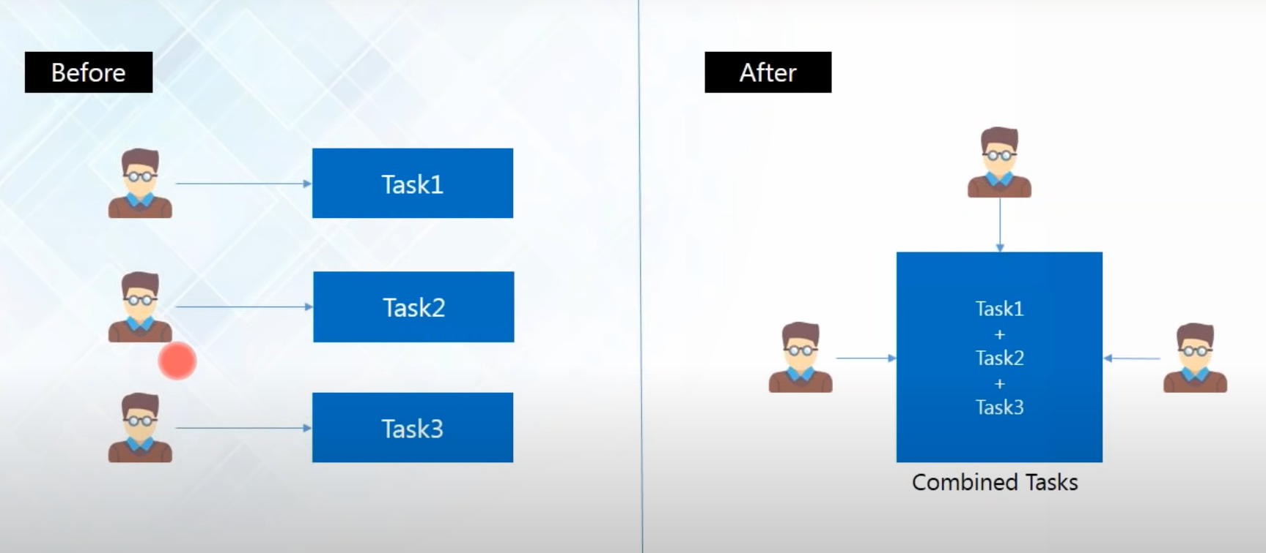
Why Version Control?
Notes:
version control because you might be thinking that why should I need a version control I know what the changes
4:53
that I have made and maybe I'm making this changes just because I'm correcting my project or something but there are a
5:00
number of things because of why we need version control and so let us take a look at them one by one so the first
5:07
thing that version control system availeth is collaboration now imagine that there are three
5:14
developers working on a particular project and everyone is working in isolation or even if they're working in
5:22
the same shared folder so there might be conflicts sometimes when each one of
5:27
them are trying to modify the same file now let's say they are working in isolation everyone is minding their own business
5:34
now the developer one has made some changes X Y Z in a particular application and in the same application
5:40
the developer too has made some kind of other changes ABC and they are
5:46
continuing doing that same thing they are making the same modifications through the same file but they're doing
5:51
it differently so at the end when you try to collaborate or when you try to merge all of their work together you
5:57
come up with a lot of conflicts and you might not know who have done what kind of changes and this will at the end end
6:05
up in chaos but with version control system it provides you with a shared workspace and it continuously tells you
6:13
who has made what kind of change or what has been changed so you'll always get notified if someone has made change in
6:19
your project so with version control system a collaboration is a page between all the developers and you can visualize
6:27
everyone's work properly and as a result your project will always evolve as a
6:32
whole from the start and it will save a lot of time for you because there won't be much conflicts because obviously if
6:39
the devil for a we'll see that he has already made some changes he won't go for that right
6:44
because he can carry out his other words you can make some other changes without interfering his word so I hope that is
6:51
understood how version control system evades collaboration if you have any questions you might ask me ok John says
6:58
yes and Tyler says yes trainer says yes ok so we'll move on to the next reason
7:07
for why we need version control system and this is one of the most important
7:13
things because of why we need version control system

Slide 4
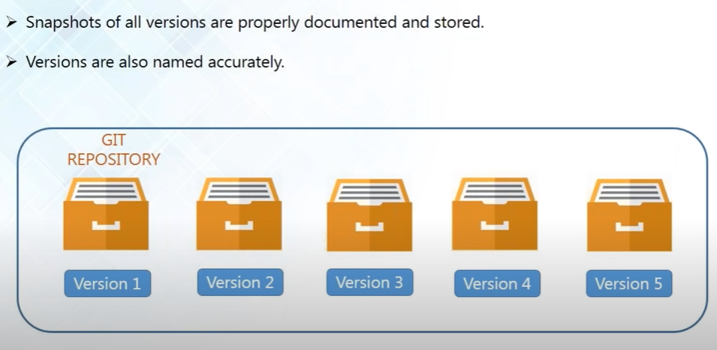
Storing Versions
Notes:
I'll tell you why now the next reason is because of
7:20
storing versions because saving a version of your project after you have made changes is very essential and
7:27
without a version control system it can actually get confusing because there
7:32
might be some kind of questions that will arrive in your mind when you are trying to save a version the first
7:38
question might be how much would you save would you just save the entire project or would it just save the
7:44
changes that you made now if you only save the changes it will be very hard
7:49
for you to view the whole project at a time and if you try to save the entire project at every time there will be a
7:56
huge amount of unnecessary and redundant data lying around because you'll be saving the same thing that has been
8:03
remaining unchanged again and again I will cover up a lot of your face and after that the another problem comes
8:10
that how do you actually name these versions now even if you are a very organized person and you might actually
8:17
come up with a very comprehensible naming scheme but as soon as your project starts varying and it comes to
8:24
variants there is a pretty good chance that you'll actually lose track of naming them and finally the most
8:31
important question is that how do you know what exactly is different between these versions now you ask me that ok
8:39
what's the difference between version 1 and version 2 what exactly was changed you need to remember or document them as
8:46
well now when you have a version control system you don't have to worry about any of that
8:51
you don't have to worry about how much you need to how do you name them or you have you
8:56
don't have to remember that what exactly is different different between the versions because the version control
9:02
system always acknowledges that there is only one project so when you're working
9:07
on your project there is only one version on your disk and everything else all the changes that you've made in the
9:13
past are all neatly packed inside the version control system and obviously like John asked that if you want to go
9:20
back to the previous version if you're not sure that the modifications you've just made are right and you want to
9:26
revert back you can do that with version control system as well because it is storing all your versions and you can
9:32
always revert back so I hope that this is clear to everyone shall I proceed
9:38
further guys okay so let us go ahead and see the next reason now version control

Slide 5
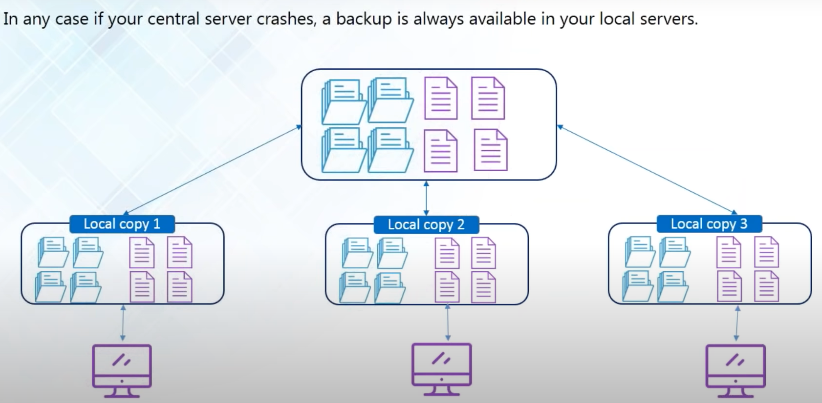
Backup
Notes:
system provides me with a backup now the diagram that is seen here is actually
9:50
the layout of typical distributed version control system here you have got
9:56
your central server where all the project files are located and apart from
10:02
that every one of the developers have a local copy of all the files that is
10:08
present in the central server inside their local machine and this is known as the local copies so what the developers
10:15
do is that every time they start coding at the start of the day they actually fetch all the project files from the
10:22
central server and store it in the local machine and after they are done working they actually transfer all the files
10:29
back into the central server so at every time you will always have a local copy
10:35
in your local machine at times of crisis like maybe let's say that your central server gets crashed and you have lost
10:42
all your project files you don't have to worry about that because all the developers are maintaining a local copy
10:48
the same exact copy of all the files that is related to your project that is
10:53
present in the central server is there in your local machine and even if let's say that maybe this developer has not
11:01
updated his local copy with all the files if he loses and the central server
11:06
gets and the developer has not maintained a circle copy is always going to be
11:11
someone who has already updated it because obviously there is going to be huge number of collaborators working on
11:17
the project so even a particular developer can communicate with other developers and get fetch all the project
11:24
files from other developers hope you copy as well so it's very reliable when you have a version control system
11:30
because you're always going to have a backup of all your files so I hope this is clear to everyone so shall I move
11:38
ahead ok

Slide 6
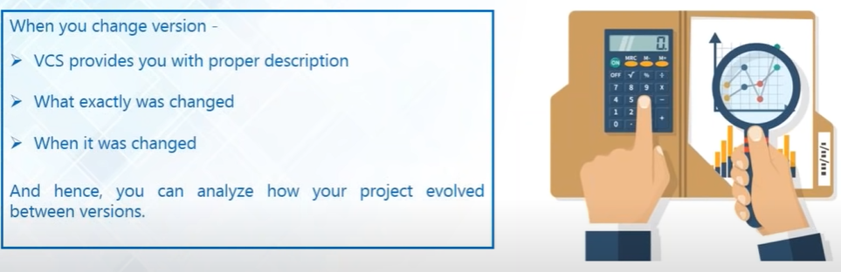
Analyze
Notes:
and you want to know that what is exactly changed and when was it change and how much time did it take and
12:10
version control system actually provides you with all the information because every time you change something version
12:17
control system provides you with the proper description of what was changed and when was it changed you can also see
12:24
the entire timeline and you can make your analysis report in a very easy way
12:30
because you have got all the data present here so this is how a version control system helps you to analyze your
12:36
project as well so it is clear to everyone any questions on this
12:41
ok so Sebastian says no all good so I hope it's clear to everyone else as well
12:47
let us move ahead and let us take a look at the version control tools because in
12:53
order to incorporate version control system in your project you have to use a
12:59
version control tool so let us take a look at what is available what kind of tools can I use to incorporate version

Slide 7

Version Control System Tools
Notes:
system tools and they are gift and this is what we'll be learning in today's
13:17
tutorial we'll be learning how to use kit apart from good you have got other options as well you've got the Apache
13:23
subversion and this is also popularly known as Sdn FCN and CVS which is the
13:30
concurrent version systems they both are a centralized version control tool it
13:36
means that they do not provide all the developers with a local copy it means
13:41
that all the contributors or all the collaborators are actually working directly with the central repository on
13:47
it they don't maintain local copy and it's kind of actually becoming obsolete because everyone prefers a distributed
13:55
version control system where everyone has a local copy and mercurial on the other hand is very similar to get it is
14:02
also a distributed version control tool but we're learning all about get here that's like it is highlighted in yellow
14:08
so let's move ahead okay there's a question from Jamie so he asked that if
14:15
all of them are open-source well I'll tell you that git is an open source okay
14:20
so shall we proceed ahead Jamie and everyone else okay so this is the

Slide 8
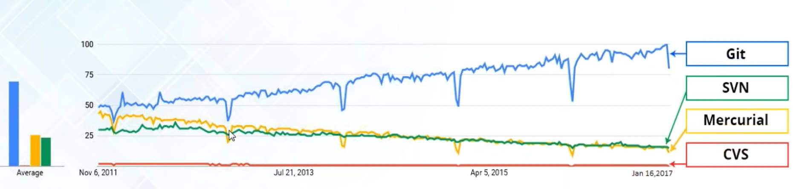
Interest Over Time Graph
Notes:
interest over time graph and this graph has been collected from Google Trends and this actually shows you that how
14:35
many people have been using what at what time so the blue line here actually
14:41
represents gives the green is SVN the yellows mercurial and the red is CDF so
14:48
you can see that from the start it has always been the most popular version control tool as compared to SPN
14:55
material and CVS and it has always kind of been a bad day for CVS but it has
15:01
always been popular so why not use git right so there's nothing to say much
15:06
about that and yes and a lot of my fellow attendees agree with me we should all use git and we're going to learn how

Slide 9
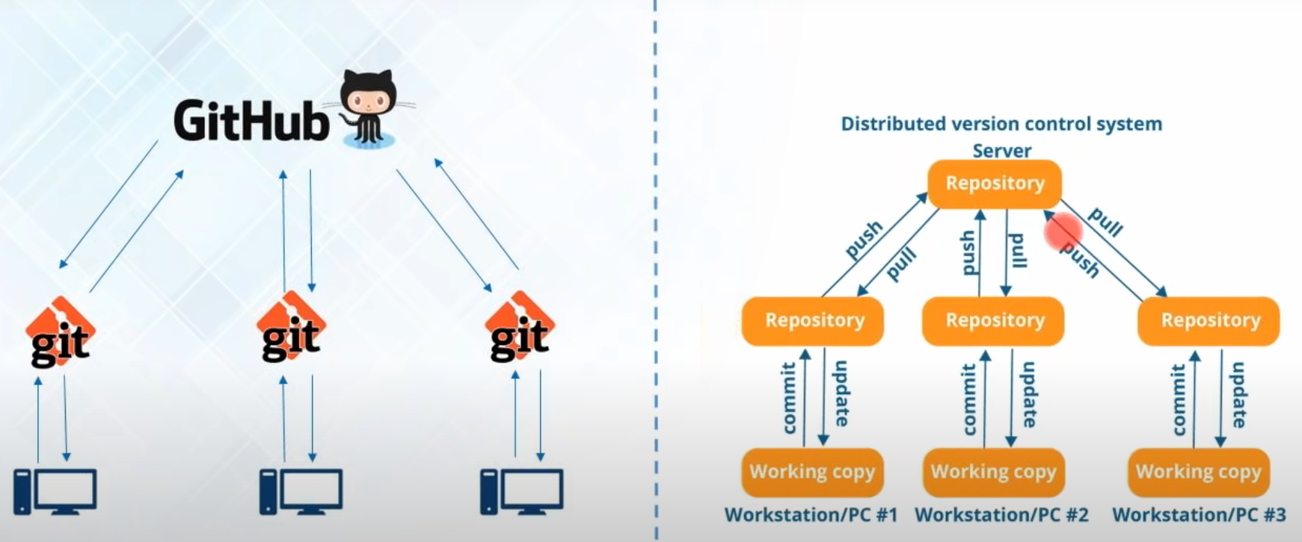
Git & Github
Notes:
diagram which represents that what exactly is github and what exactly is git now I've been talking about a
15:32
distributed version control system and the right hand side diagram actually shows you the typical layout of
15:38
a distributed version control system here it is got a central server or a central repository now I'll be using the
15:45
word repository a lot from now on just so that you don't get confused I'll just give you a brief overview I'll also tell
15:52
you in detail what is the repository and I'll explain you everything later in this tutorial but for now just consider
15:59
repository as a data space where you store all the projects files any kind of
16:05
files that is related to your project in there so don't get confused when I say repository instead of server or anything
16:12
else so in a distributed version control system you've got a central repository
16:17
and you've got local repositories as well and every of the developers at
16:23
first make the changes in their local repository and after that they push
16:28
those changes or transfer those changes into the central repository and also
16:34
they update their local repositories with all the new files that are pushed into the central repository by an
16:41
operation called pull so this is how the fetch data from central repository and now if you see
16:48
the diagram again on the left you know that github is going to be my central
16:53
repository and git is the tool that is going to allow me to create my local repositories now let me exactly tell you
17:01
what is github now people actually get confused between git and github they
17:06
think that it's kind of the same thing maybe because of the name they sound very alike but it is actually very
17:13
different well git is a version control tool that will allow you to perform all these kind
17:18
of operations to fetch data from the central server and to just push all your
17:23
local files into the central server so this is what git will allow you to do it
17:28
is just a version control management tool whereas in github it is a code
17:35
hosting platform for version control collaboration so github is just a
17:40
company that allows you to host your central repository in a remote server
17:47
if you want me to explain in easy words you can consider github as a social
17:52
network which is very much similar to Facebook like only the difference is that this is a social network for the
17:59
developers where in facebook you're sharing all your photos and videos or
18:05
any kind of statuses what the developers do in github is that they share their code for everyone to see their project
18:11
see their code about how they've worked on so that is good help ok I've got a
18:17
question from Jamie and yes that are there any advantages over centralized
18:24
versions control system over distributed version control system well of course there are certain advantages of a
18:31
distributed version control system well the first thing that I've already discussed was that it provides you with
18:37
the backup so if at any time your central server crashes everyone will have a backup of all their files and the
18:45
next reason is that it provides you with speed because central server is typically located on a remote server you
18:52
have to always travel over a network to get access to all the files so if at some times you don't have internet and
18:58
you want to work on your project so that will be kind of impossible because you don't have access to all your files but
19:04
with the distributed version control system you don't need internet access always you just need internet when you
19:10
want to push or pull from the central server apart from that you can work on your own your files are all inside your
19:17
local machine so fetching it in your workspace is not a problem so that are all the advantages that you
19:24
get with a distributed version control system and a centralized version control system cannot actually provide you that
19:30
so is it ok so did you get your answer Jamie ok so Jamie has asked another
19:38
question how is the local repository connected to the cloud repository well I'll actually show you this you
19:46
have to add an origin and you can it is also connected via SSH if you want to or
19:51
you can send our HTTP request and connect to the central server as well so
19:57
there are a number of ways to do it I will be showing you Jamie so Jamie have you got your answers okay
20:03
Jamie says yes and I've got a couple of other questions as well
20:09
okay so Sebastian has a question here he asked that so we do all the
20:15
modifications and get and once it is done we'll push it to github and after
20:22
that how can we automate this process well you can automate this process
20:27
Sebastian you can use a Java settler or a Crone tab to automate all your push
20:33
and pull operations but you kind of don't want to do that because the whole
20:38
essence of having a local repository is that you are always free to make changes
20:44
in the central repository when you want it because sometimes if you're not done working on a particular file and if you
20:51
have just set a job scheduler it will automatically actually push your unfinished work and you don't want to do
20:57
that because everyone else will see and it might actually interfere with the work and sometimes when you're pulling
21:04
changes it actually updates your current workspace so if you're working on
21:09
something and it's automatically pulling out the files and it's making changes automatically you might get confused but
21:16
if you still want to do that it is possible you can use a job scheduler for that but I will advise you not to do
21:23
that which is the whole purpose of having distributed version control system is that you can work in isolation
21:29
and whenever you're sure that your code is working fine and you want others to see that then you can push it on to
21:35
github so Sebastian have you got your answer okay Thank You Sebastian and
21:43
thank you Jamie for asking questions and if any of you has any other questions you can always ask me so shall I proceed
21:50
further ok

Slide 10
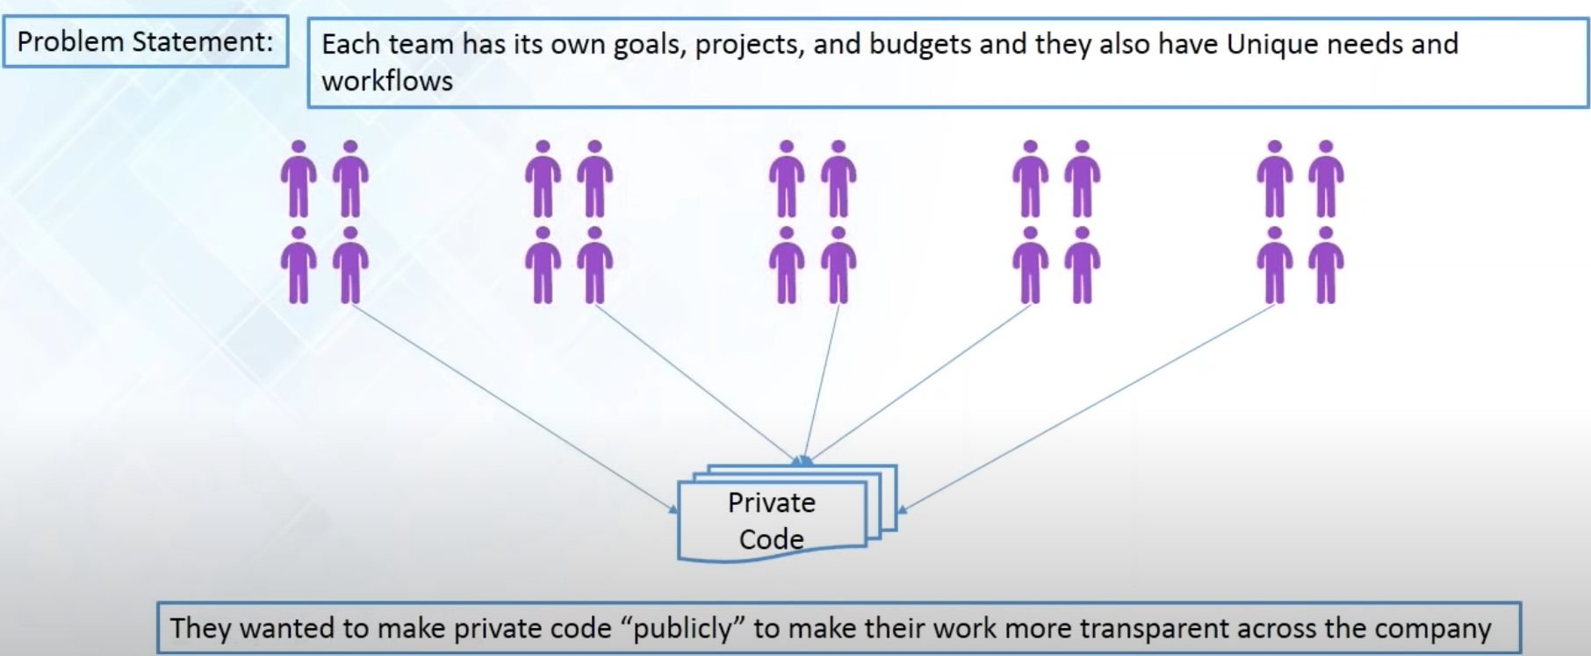
Dominion Enterprises Case-Study
Notes:
so now let's take a look at a
21:56
github case study of the Dominion enterprises so Dominion enterprises is a
22:03
leading marketing services and publishing company that works across several industries and they have got
22:09
more than 100 offices worldwide so they have distributed a technical
22:15
team support to develop a range of a website and they include the most popular websites like forrent.com
22:23
boats comm homes comm all the domain Ian's enterprises websites actually get
22:30
more than tens of million unique visitors every month and each of the
22:36
website that they work on has a separate development team and all of them has got
22:41
a unique needs and you need to workflows of their own and all of them were working independently and each team has
22:49
their own goals their own projects and budgets but they actually wanted to share their resources and they wanted
22:56
everyone to see what each of the teams are actually working on so basically
they wanted transparency well they needed a platform that was flexible enough to support a variety of workflows
and that would provide all the Dominion enterprises development around the world with a secure place to share code and
work together and for that they adopted github as the platform and the reason

Slide 11
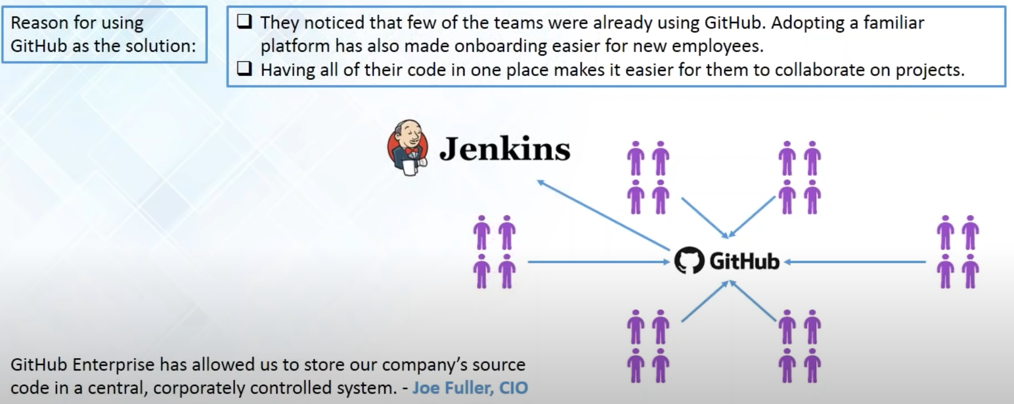
Dominion Enterprises Case-Study(Cont.)
Notes:
for choosing github is that all the developers across the Dominion enterprises we're already using
23:27
github.com so when the time came to adopt a new version control platform so
23:33
obviously a github Enterprise definitely seemed like a very intuitive choice and because everyone all the developers were
23:40
also familiar with github so the learning curve was also very small and so they could start contributing or
23:47
right away into github and with github all the developer teams all the development teams were provided access
23:54
to when they can always share their code on what they're working on so at the end everyone has got a very secure place to
24:01
share code and work together and as Joe fuller the CIO of Dominion enterprises
24:08
says that github enterprises allowed us to store our company's source code in a
24:13
central corporately control system and dominion enterprises actually manages
24:19
more than 45 websites and it was very important for Dominion enterprise to
24:24
choose a platform the made working together possible and this wasn't just a matter of sharing Dominion
24:31
enterprises open source project and github they also had to combat the implications of soaring private code
24:37
publicly to make their work more transparent across the company as well and they were also using Jenkins to
24:44
facilitate a continuous integration environment and in order to continuously deliver their software they have adopted
24:52
github as a version control platform so git have actually facilitated a lot of
24:58
things for Dominion enterprises and for that they were able to incorporate a
25:03
continuous integration environment with Jenkins and they were actually sharing their code and making software delivery
25:09
even more faster so this is how github helped not only discriminate enterprises
25:15
but I'm sure this might be common to a lot of other companies as well shall I move forward ok Jamie says it doesn't
25:22
have any questions so let us move forward but if at any time if any kind of question arises you might ask me at
25:29
all times so now this is a topic that we were waiting for and now we'll learn
25:36
what is get so git is a distributed version control tool and it supports

Slide 12
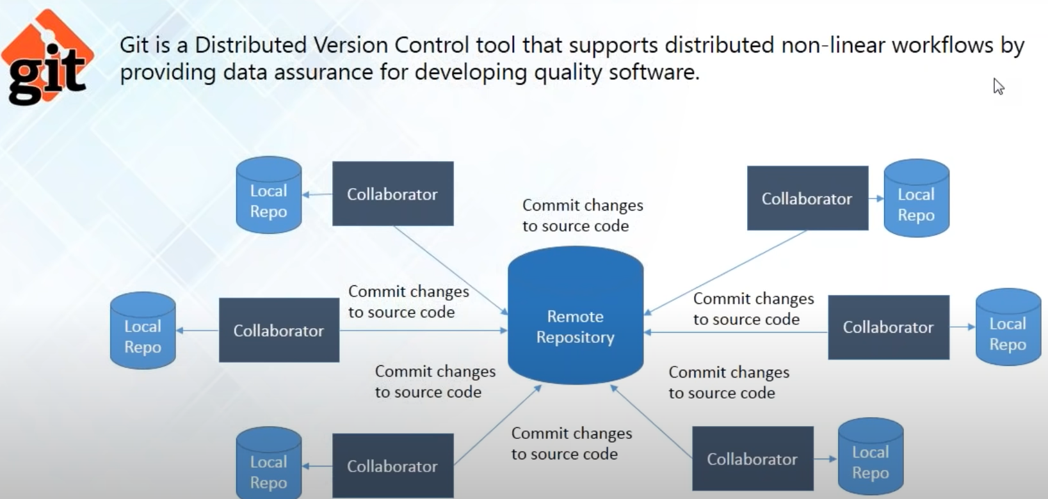
What is Git?
Notes:
distributed nonlinear workflow forgetting the tool that actually facilitates all the distributed version
25:49
control system benefits because it will provide you to create a local repository
25:54
in your local machine and it will help you to access your remote repository to
25:59
fetch files from there or push files into that so git is the tool that you
26:04
require to perform all these operations and I'll be telling you all about how to perform this operation for using git
26:11
later in this tutorial for now just think of git as the tool that you actually need to do all kind of
26:18
version control system stuff so do you have any questions on what is git ok so
26:23
jamie has a question can two people contribute in one local repository well
26:30
a local repository resides in your local machine so now if two people are using the same machine obviously but you don't
26:37
want that because every developer got their own machines so there's no use of create like having sharing a local
26:44
repository it's all meant to work in isolation but if you want to create a
26:50
subgroup let's say that these three collaborators are working on a similar
26:55
kind of application of that project and these two are working on a little more similar but that's different to this and
27:02
said so they want another repository before they're committing to the repository well you can do that as well
27:08
you can place any other repository where in a few people can collaborate we're working in the entire project as well as
27:15
for now the local repository here is the repository that actually resides in your local machine ok so jamie has another
27:22
question here how's that how can I share commits with only a specific person without committing in the remote repo
27:28
well no you cannot actually commit something in other persons repositories and only committed in your local
27:35
repository and a remote repository so the remote repository is where everyone can see what changes you have made and
27:42
what kind of commit you have made in the project and in the local repository the
27:47
comment you made is only can be seen by yourself and the local repository is only meant for your use and after you
27:55
make commits in the local repository then only you can make changes or transfers those changes into the remote
28:01
repository but since all of you are connected over a network you might like hat you can take advice from your fellow
28:07
collaborators but it cannot actually show the commits directly to him without committing into a remote repository
28:14
where both of you have access to so Jamie's answer clear to you ok so Jamie says yes so we'll move on
28:23
and we'll see the different features of git now so these are the different
28:30
features of git is distributed get is compatible get a provider with a
28:35
nonlinear workflow

Slide 13
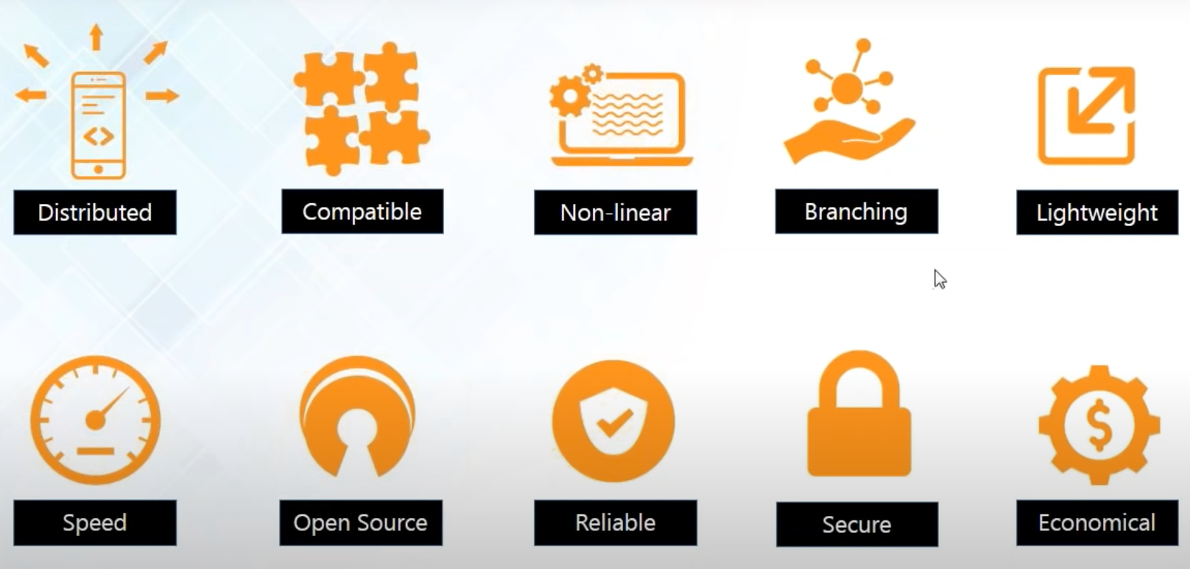
Features of Git
Notes:
it's reliable secure and economical so let's take a look at all the features
28:48
one by one so at first it is distributed
28:53
okay so Sebastian asked the questions is that what is a collaborator actually is
29:00
it a service well collaborator is a person who collaborates something in your work so this is pretty much like
29:07
the English word where collaboration actually means it means our combined contribution so the collaborator when
29:13
I'm saying collaborator I just mean a developer who has been working on the project so if there are a lot of
29:19
developers working on the similar project and they're all contributing into the project I'm just naming them as
29:25
collaborators so so in this tutorial when I'm saying collaborate I mean a person a developer who has been
29:31
contributing his code so Sebastian is the answer clear to you okay Sebastian
29:36
says got it Thank You Sebastian so the first feature that we're going to look
29:42
into is its distributed now I've been like telling you it's the distributed
29:47
version control tool it means that the feature that gets provides you is that it gives you the power of having a local
29:54
repository and lets you have a local copy of the entire development history which is located in the central
30:01
repository and it will fetch all the files from the central repository to get your local repository always updated and
30:09
this I'm calling it distributed because every let's say that there might be a
30:14
number of collaborators or developers so they might be living in a different
30:20
parts of the world someone might be working from the United States and one live in India so the words the project
30:27
is actually distributed everyone has a local copy so it is distributed worldwide you can say so this is what
30:35
distributed actually means so the next feature is that it is compatible now
30:41
let's say that you might not be using git on the first place but you have a
30:46
different version control system already installed like SBN like a party
30:51
subversion or CVS and you want to switch to get because obviously you are not happy with the centralized version
30:58
control system and you want a more distributed version control system so you want to migrate from Sdn to get but
31:05
you're worried that you might have to transfer all the files all the huge amount of files that you
31:10
have in your SVN repository into a git repository well if you are afraid of
31:16
doing that let me tell you you don't have to be anymore because git is compatible with SVM repositories as well
31:22
so you just have to download and install git in your system and and it can
31:28
directly access the SVN repository over the network which is the central repository so the local repository that
31:35
you'll have is going to be a git repository and if you don't want to change your central repository then you
31:41
can do that as well we can use git sdn and it can directly access all the files all the files in your project that is
31:48
residing in an SVM depository so you don't have to change that and it is
31:54
compatible with existing systems and protocols but there are protocols like SSH and winner in protocol so obviously
32:01
get users SSH to connect to the central repository as well so it is very compatible with all the existing things
32:08
so you don't have to so when you're migrating into kit when you were starting to use git you don't have to actually change a lot of things so if I
32:16
have everyone understood these two features by so far okay the next feature
32:22
of git is that it supports nonlinear development of software now when you're
32:27
working with get it get actually records the current state of your project by
32:33
creating a tree graph from the index a tree that you know is nonlinear now when
32:39
you're working with git it actually records the current state of the project by creating a tree graph from the index
32:45
and as you know that a tree is a nonlinear data structure and it is
32:51
usually actually in the form of a directed acyclic graph which is popularly known as the daj so this is
32:58
how actually get facilitates a nonlinear development of software and it also
33:04
includes techniques where you can navigate and visualize all of your work that you're currently doing and how does
33:10
it actually facilitate and when I'm talking about non-linearity how does it
33:15
get actually facilitate a nonlinear develop is actually by branching now branching
33:21
actually allows you to make a nonlinear software development and this is a good
33:28
feature that actually make it stand apart from nearly every other version
33:34
control management tool because git is the only one which has a branching model
33:39
so git allows and it actually encourages you to have a multiple local branches
33:45
and all of the branches are actually independent of each other and the
33:50
creation and merging and deletion of all these branches actually takes only a few
33:55
seconds and there is a thing called the master branch it means the main branch which starts
34:01
from the start of your project to the end of your project and it will always contain the production quality code it
34:08
will always contain the entire project and after that it is very lightweight
34:15
now you might be thinking that since we're using local repositories on our local machine and we're fetching all the
34:22
files that are in the central repository and if you think that way you can know that there are like honey there are
34:28
hundreds of people pushing their code into the central repository and I'm updating my local repository with all
34:34
those files so the data might be very huge but actually good uses a lossless
34:40
compression technique and it compresses the data on the client side so even though it might look like that it's got
34:47
a lot of files when it actually comes to storage or storing the data in your local repository it is all compressed
34:54
and it doesn't take up a lot of space only when you're fetching your data from the local repository into your workspace
35:00
it converts it and then you can work on it and whenever you push it again you compress it again and store it in a very
35:07
minimal space in your disk and after that it provides you with a
35:12
lot of speed now since you have a local repository and you don't have to always travel over a network to fetch files so
35:20
it does not take any time to get files in your into your work space from your local repository because and if you see
35:27
that it is actually hundred times faster detecting data from a remote repository
35:32
because because obviously have to travel over the network to get that data or the files that you want and Mozilla has
35:40
actually performed some kind of performance test and it is found out that git is actually one order of
35:47
magnitude faster than other version control tools which is actually equal to ten times faster than other version
35:55
control tools and the reason for that is because git is actually written in C and
36:01
C is not like other high-level languages it is very close to machine language so
36:06
it reduces all the runtime overheads and it makes all the processing very fast so
36:12
get is very small and a get is very fast and the next feature is that it is open
36:18
source well you know that it was actually created by Linus Torvalds and he is the famous man who created the
36:24
Linux kernel and he actually used git in the development of the Linux kernel now
36:30
they were using a version control system called bitkeeper first but it was not open source day so the owner of
36:37
bitkeeper has actually made it a paid version and this actually got Linus Torvalds mad so what he did is that he
36:45
created his own version control system tool and he came up with git and he made
36:50
it open source for everyone so that you can so the source code is available and you can modify it on your own and you
36:57
can get it for free so there is one more good thing about git and after that it
37:03
is very reliable like I've been telling you since the Stars that a have a backup
37:08
of all the files in your local repository so if your central server crashes you don't have to worry your
37:13
files are all saved in your local repository and even if it's not in your local repository it might be in some
37:20
other developers local repository and you can tell him what and whenever you need from that data and you lose the
37:25
data and after your central server is all repaired if it was crashed he can directly push all the data into the
37:32
central repository and from there everyone else can always have a backup here and Sebastian says I guess even
37:39
they would have a backup for central repository yeah you can do that it you are not if you think that your
37:45
developers are not trustworthy enough that they might not be pulling codes regularly and you want to make sure that
37:52
you don't have to actually contact each of the collaborators or the developers on events like this you can always
37:59
maintain a duplicate copy of your central repository but if you don't want
38:04
to waste more money or more space you can always rely on your developers as
38:11
well but if you want to do it and I think it is advisable to have a duplicate copy of your central
38:16
repository like Sebastian you said you can do that as well okay so and Sebastian are you satisfied with my
38:23
answer okay says yes so the next thing is that kid is actually very secure now git uses
38:30
the sha-1 do name and identify objects so whenever you actually make change it
38:37
actually creates a commit object and after you have made changes and you have committed to those changes it is
38:44
actually very hard to go back and change it without other people knowing it
38:49
because whenever you make it commit the sha-1 actually converts it well okay so
38:56
Jonathan what is sha-1 well it is a kind of cryptographic algorithm it is a
39:02
message digest algorithm that actually converts your commit object into a 40 digit hexadecimal code now sha I uses
39:10
techniques and algorithms like md4 and md5 and it is actually very secure it is
39:17
considered to be very secure because even the National Security Agency of the United States of America uses SSA I so
39:24
if they're using it you might know that it is very secure as well and if you want to know what 75 and message digest
39:32
I'm not going to take you through the whole algorithm whole cryptographic algorithm about how they make that
39:39
cipher and all you can google it and you can learn what it is hei but the main concept of it is that after you have
39:46
made changes you cannot deny that you have not made changes because it will
39:51
store it and everyone can see it it will create a commit
39:56
for you so everyone will see it and this commit hash in is also useful when you
40:01
want to revert back to previous versions you want to know that which commit exactly caused what problem and if you
40:08
want to remove that commit if you want to remove that version you can do that because sha I will give you the hash log
40:15
of every covet okay so Jamie ask any revert back to the previous commit of course we can avert
40:21
back to a previous commit you can see what was exactly changed and if you want Jamie I can show you that in a while
40:26
that I can revert back to a previous commit okay so Jamieson is cool so let's move
40:33
on and see the next feature which is economical now git is actually released
40:39
under the general public's license and it means that it is for free you don't have to pay any money to download get in
40:47
your system you can have kid without burning a hole in your pocket and since all the heavy lifting is done on the
40:54
kind side because everything you do you do it on your own entire workspace and
40:59
you push it into the local repository first and after that it's pushing the central server so it means that people
41:06
are only pushing into the central server after when they're sure about the work and and they're not experimenting on the
41:14
central repository so your central repository can be very simple and if you don't have to worry about having a very
41:20
complex and very powerful hardware and a lot of money can be saved on that as
41:25
well so to get a free get is small so git provides you with all the cool
41:31
features that you would actually want so this were all the gift features if you
41:36
have any questions on that you might ask me and if not we'll go ahead to the next
41:41
topic okay so we'll go ahead to the next topic our next aisle so first we'll see what

Slide 14
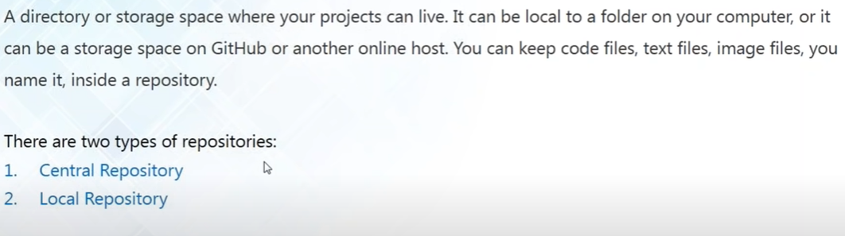
What is a Repository
Notes:
o first we'll see what
41:48
is a repository now as github says it it is a directory or storage space where
41:55
all your projects can live it can be local to a folder on your computer like your local repository or it can be a
42:02
storage space and github or another online host it means your central repository and it can keep your code
42:09
file sticks image files you name it you can keep it inside a repository everything that is
42:15
related to your project and like I have been chanting since the start of this tutorial that we have got two kinds of
42:22
repositories we've called the central repository and we've called the local repositories and now let us take a look
42:28
at what this repulsive trees actually are

Slide 15
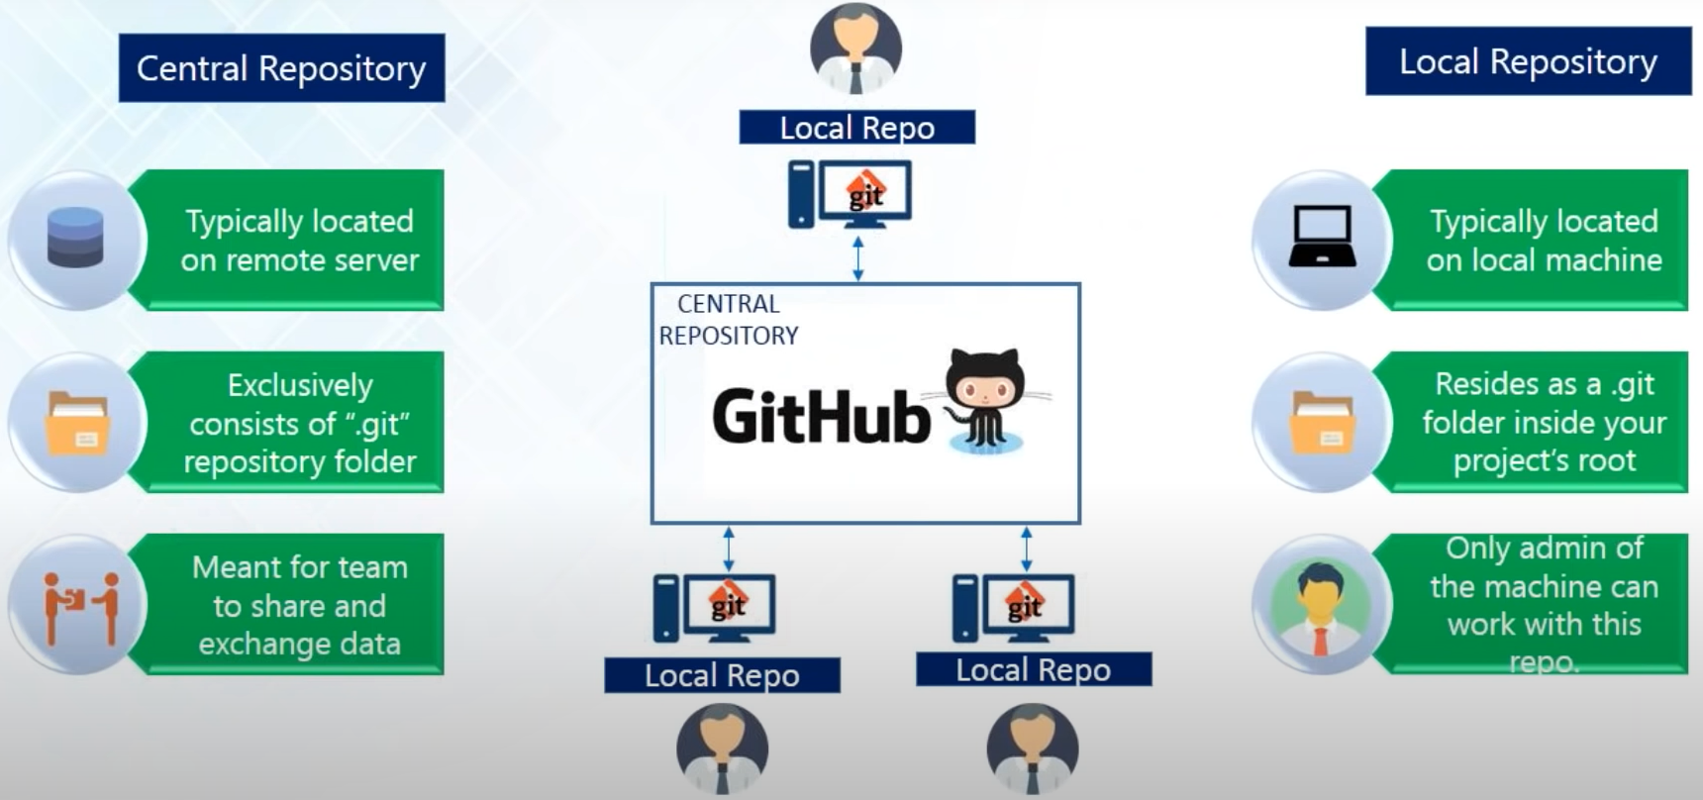
Central and Local Repository
Notes:
so on the left-hand side you can see
42:33
all about the central repository and in the right hand side this is all about my local repository and the diagram in the
42:40
middle actually shows you the entire layout so the local repository will be
42:45
inside my local machine and my simple repository for now is going to be on github so my central repository is
42:53
typically located on the remote server and like I just saw earlier if typically located on github and my local
43:00
repository is going to be my local machine as we slide in as in a dot git
43:05
folder and it will be inside your project root the dot git folder is going to be inside your project's root and
43:11
then you contain all the templates and all the objects and every other configuration files when you create your
43:18
local repository and since you're pushing all the code your central repository will also have the same dot
43:24
git repository folder inside it and the sole purpose of having a central repository is so that you're all the
43:31
collaborators or all the developers can actually share and exchange state data because someone might be working on a
43:38
different problem and someone might be needing help and that so what he can do is that he can push all the code all the
43:45
problems that he has solved or something that he has worked on into the central repository and everyone else can see it
43:51
and everyone else can pull his code and use it for themselves as well so this is
43:56
just meant for sharing data where is in local repository it is only you can
44:03
access it and it is only meant for your own so you can work in your local repository you can work in isolation and
44:09
no one will interfere you and after you're done after you're sure that your code is working and you want to show it
44:16
to everyone just transfer it or push it into the central repository okay so now

Slide 16
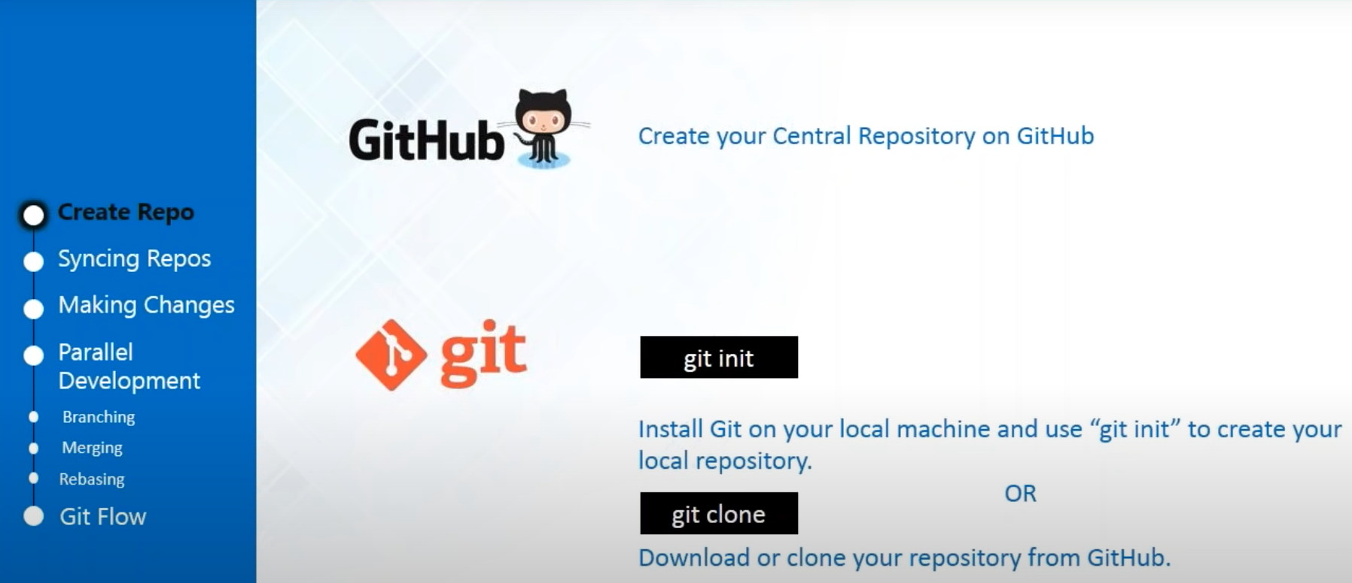
Git Operations & Commands
Notes:
we'll be seeing the gate operations and commands this is how we'll be using it
44:28
there are various operations and commands that will help us to do all the
44:33
things that we were just talking about right now we're talking about pushing changes so these are all get operations
44:41
so we'll be performing all this operations will be creating repositories with this command will be making changes
44:47
in the files that are in our repositories with the commands will be also doing parallel nonlinear
44:53
development that I was just talking about and also this thinking of repositories so that our central
45:00
repository and local repository are connected so I'll show you how to do that one by one so let's start but
45:07
before that has anyone got any kind of questions or shall I just move forward
45:13
okay so Sebastian says move forward no doubts and so let us move forward and
45:19
see these operations one by one so the first thing that we need to do is create
45:25
repositories so we need a central repository and we need a local repository now will host our central
45:33
repository on github so for that you need an account and github and create a
45:38
repository there and for your local repository you have to install git in your system and if you are working on a
45:46
completely new project and if you want to start something fresh and very new you can just use git init to create your
45:53
repository or if you want to join an ongoing project and if you're new to the
45:58
project and you just join so what you can do is that you can clone the central repository using this command git float
46:05
so let us do that so let's first create a github account

Slide 17
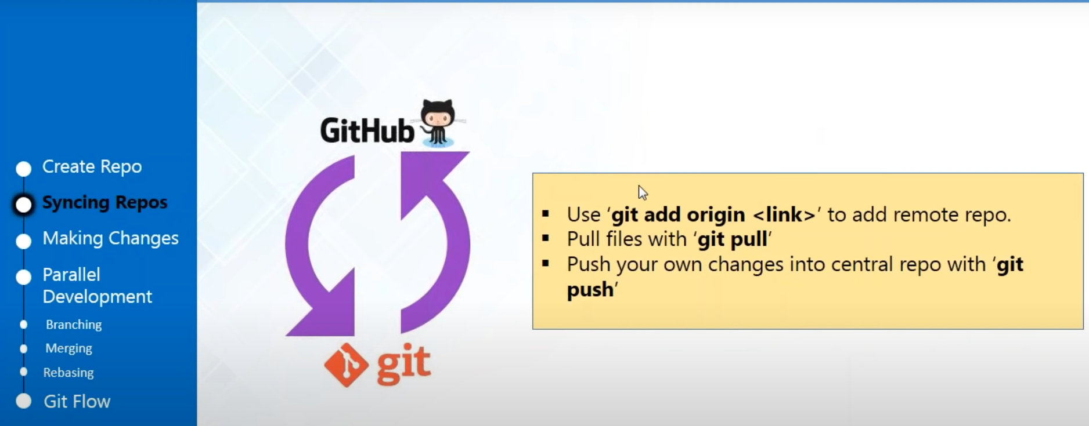
Syncing Repositories

Slide 18
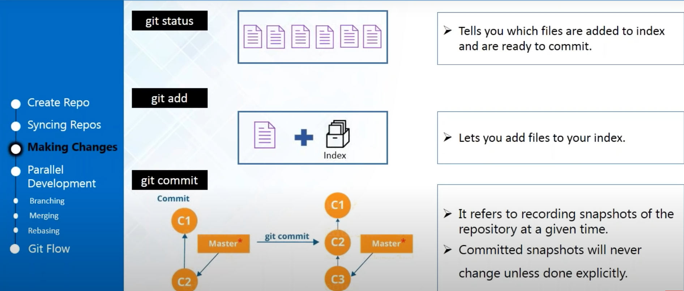
Making Changes

Slide 19
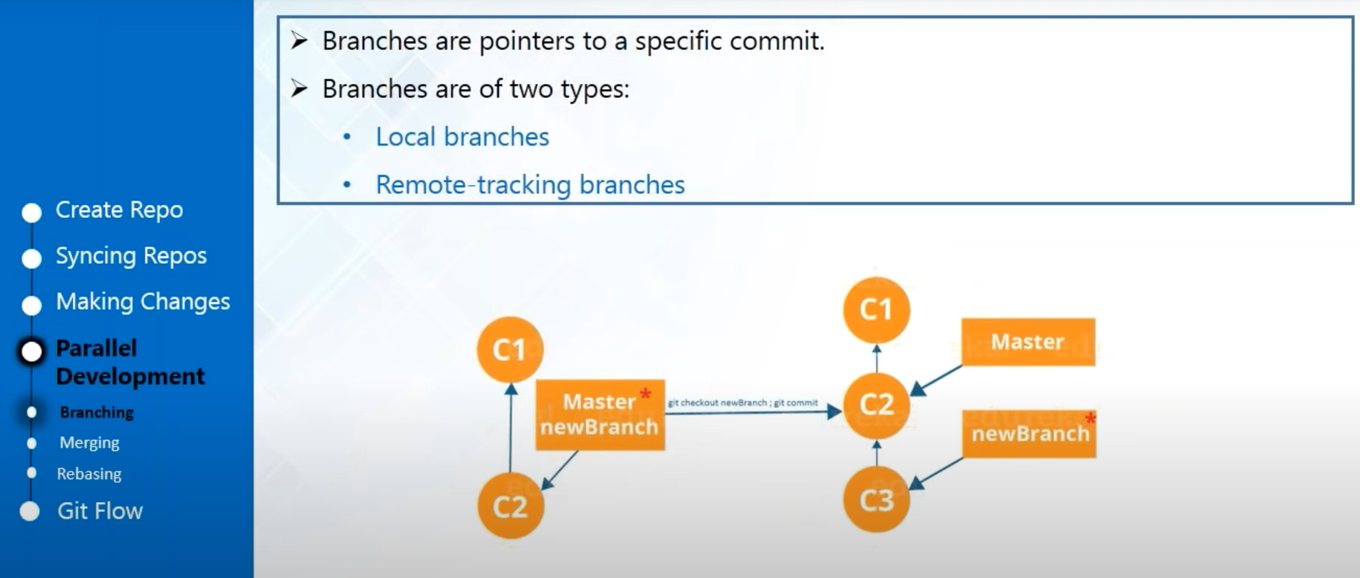
Parallel Deployment - Branching

Slide 20
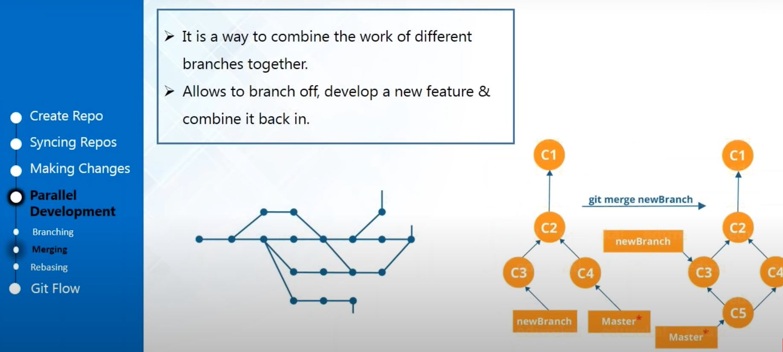
Parallel Deployment - Merging

Slide 21
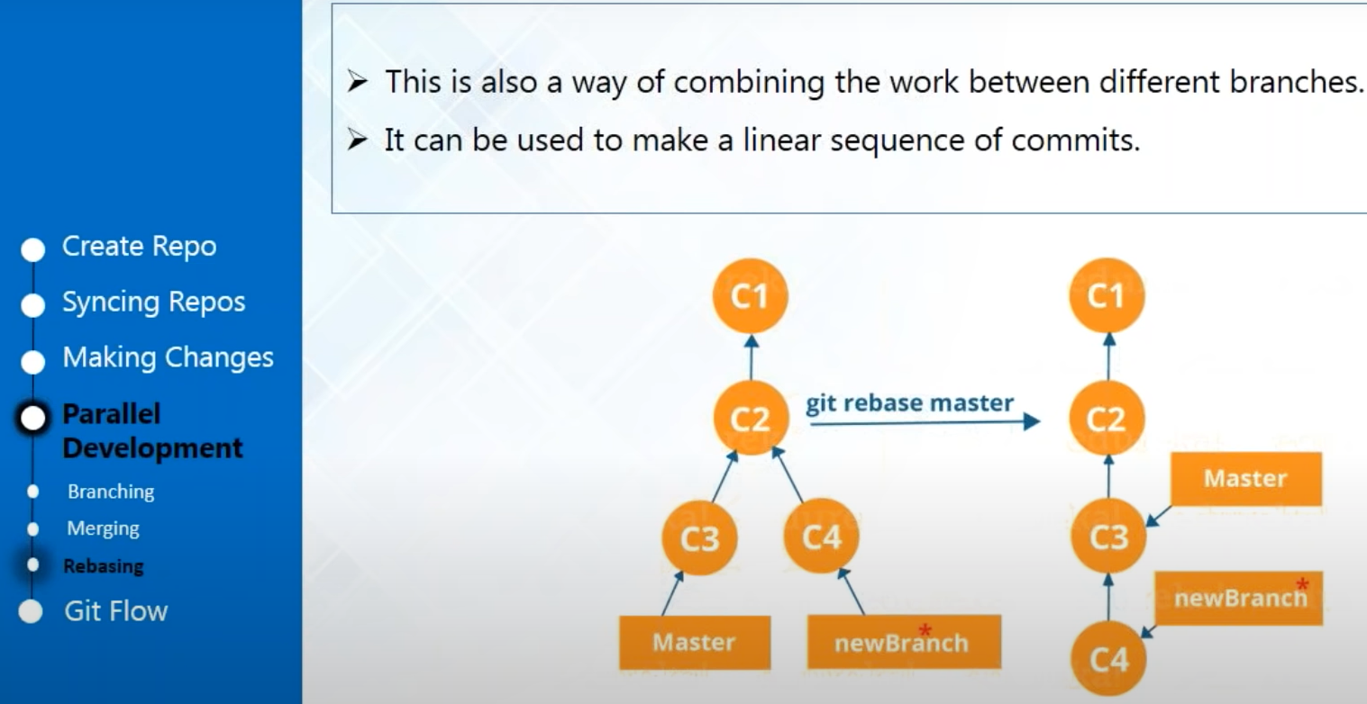
Parallel Development - Rebasing

Slide 22
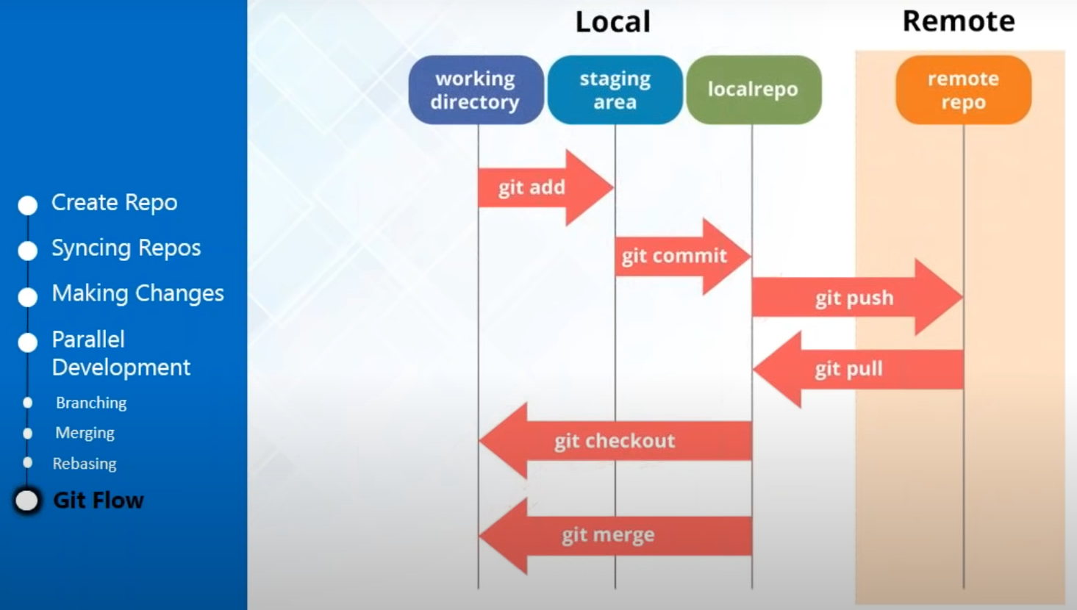
Git Flow

Slide 23
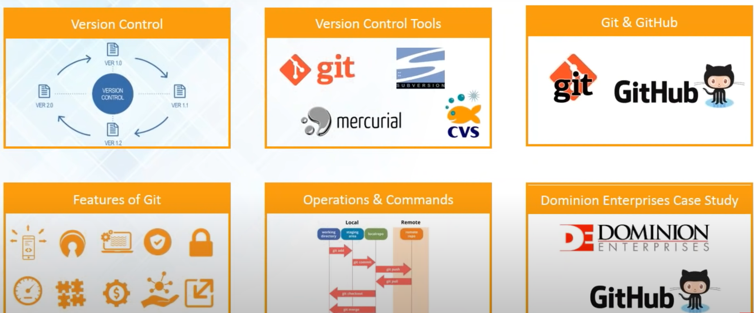
Summary

